Slide 1
TripAdvisor versus AirBnb
Application Analysis
Group 6:
Wenxi Huang
Claudio Romano
Zhaolin Wang
Ashley Marin-Stoddart
Samantha Mighty
Flavia Kuhn

Slide 2


Project Context
The purpose of this analysis is to compare online hotel and room reservation service, Trip Advisor to AirBnb, an alternative online vacation home rental and room reservation application.
The analytical goal is to review the similarities/differences across the two platforms. Looking at the platform types, we look to better understand how the users/clients responded to the locations and offering via their reviews, their overall ratings and to distinguish patterns such as preference based on keywords and entities.
Business goals: To understand what the client is looking for in regards to room reservations and what features affects their ratings and sentiment scores.
Business process to be analyzed: Which platform is more utilized and how to improve room reservation applications.

Slide 3
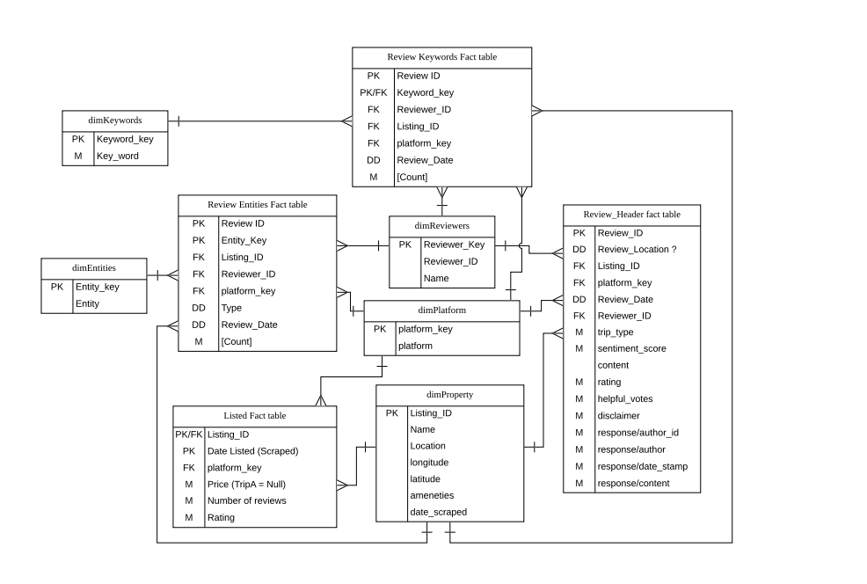
Star Schema
Notes:
Dimensional modeling aspects of the business process(es) -- conformed dimensions, facts/measures granularity...

Slide 4
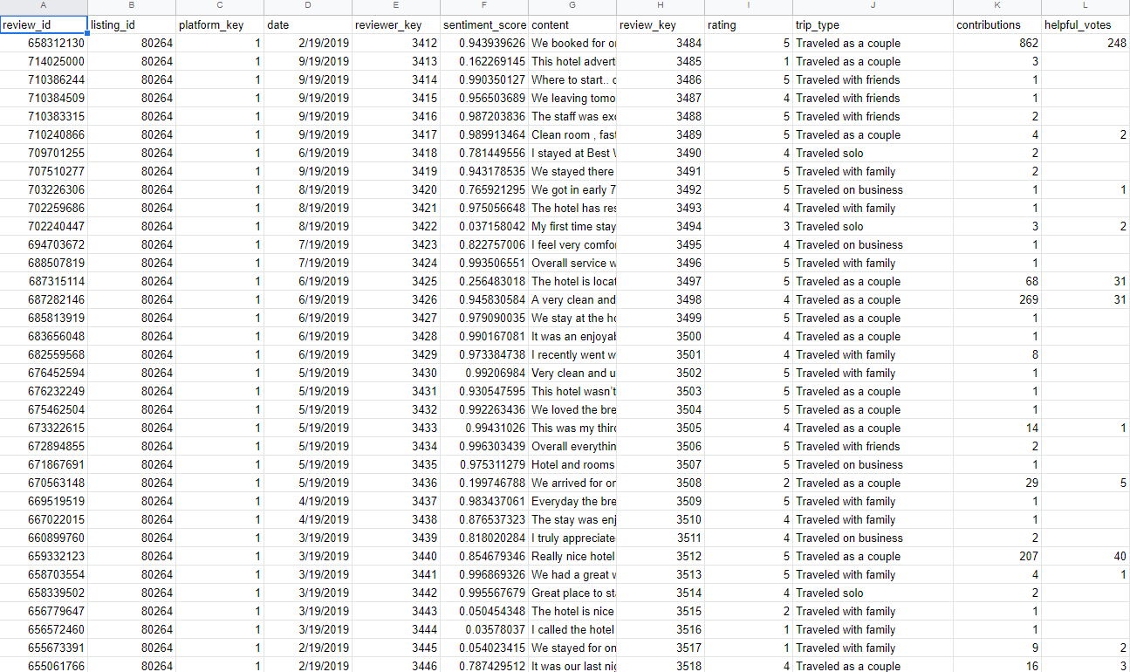
Sample Rows of Data
Review Header Fact Table

Slide 5
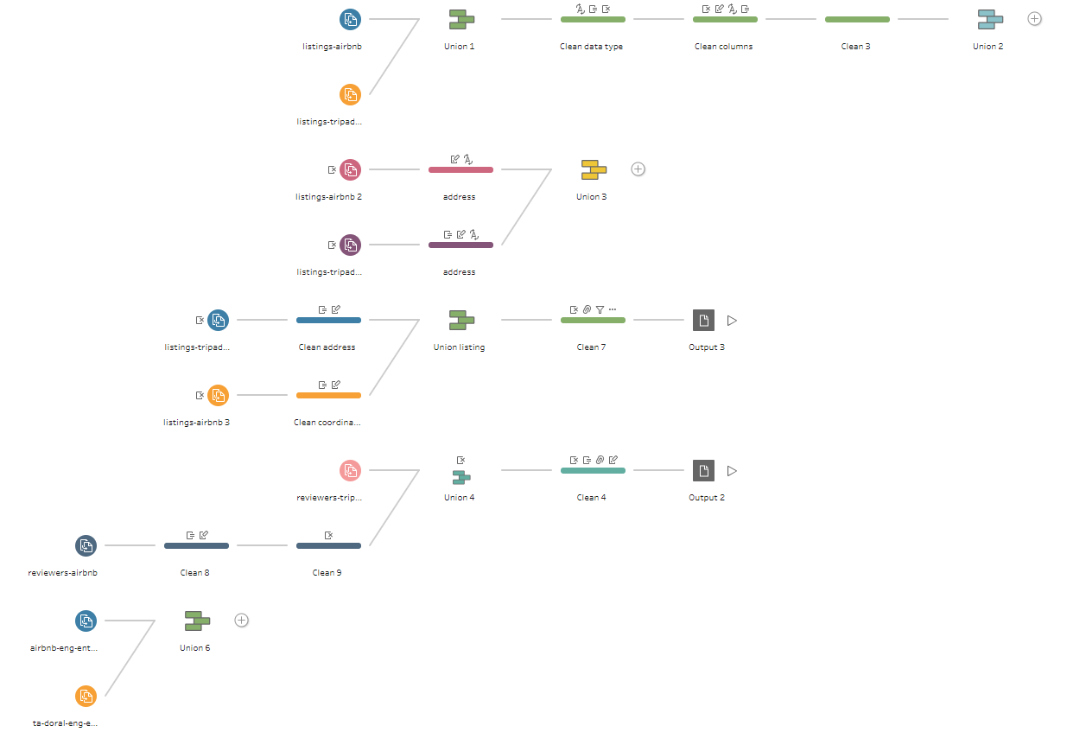
ETL

Slide 6
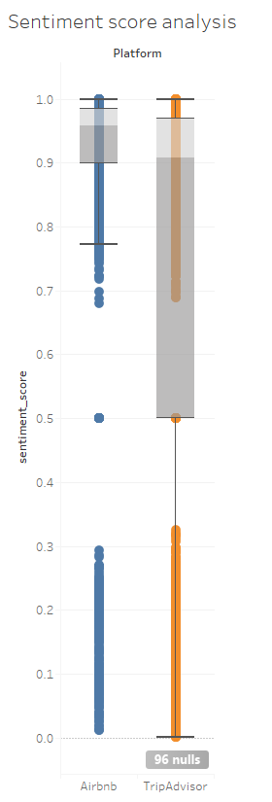
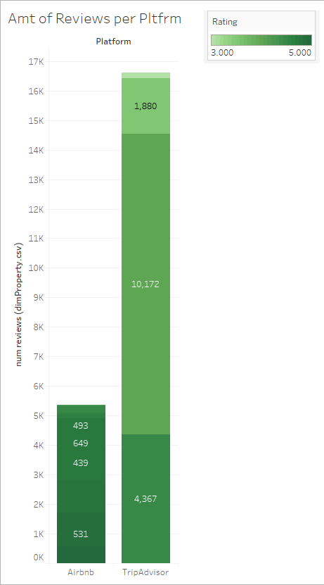
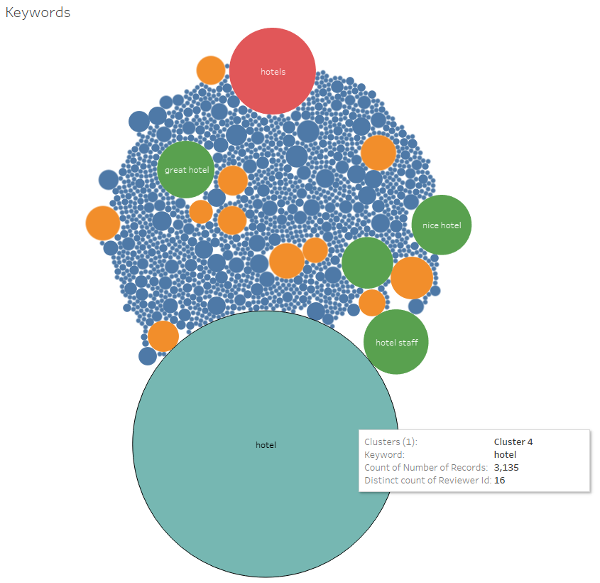
Tableau Reports

Slide 7
Questions that could not be assessed:
Possible interests to the business that couldn’t be answered by the available data.
If a user has used both tripAdvisor or AirBnb accounts.
Cannot be determined based off of usernames alone.
Platforms are not connected by any references.
Forecast future ratings for potential new location and the seasonal correlations?
Not enough data for forecast and seasonal correlations
Whether more amenities means higher rating per Platform?
Amenity data is not applicable for review in its current format using tableau.
Further data granularity is required.
Missing Data for Airbnb.

Slide 8


Slide 9

Q & A
Thanks for your time and patience!

